Slide 1
Bio& 242:
Unit 2 / Lecture 1

Slide 2
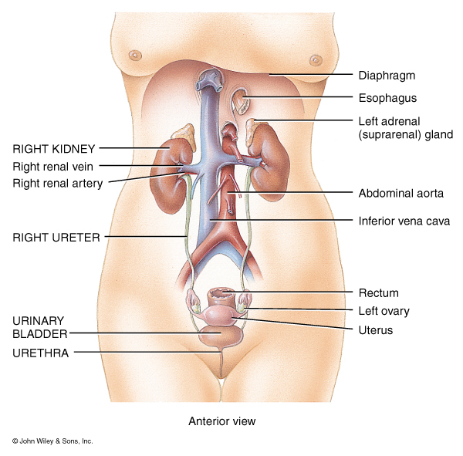
Major Functions of the Kidneys and the Urinary System
Regulation of blood ionic composition
Maintenance of blood osmolarity
Regulation of blood volume
Regulation of blood pressure
Regulation of blood pH

Slide 3
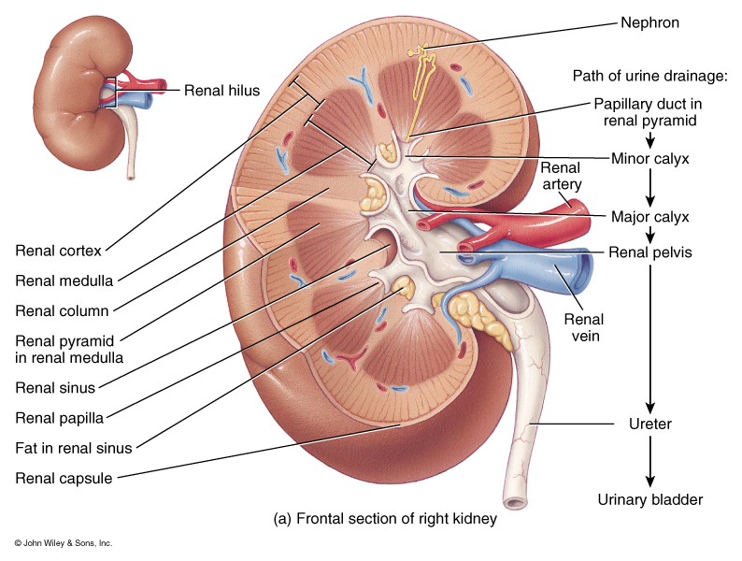
Major Functions of the Kidneys and the Urinary System
Release of hormones
calcitriol – active form
of Vitamin D, helps control calcium homeostasis.
erythropoietin – stimulates RBC production
Regulation of blood glucose levels via
gluconeogenesis

Slide 4
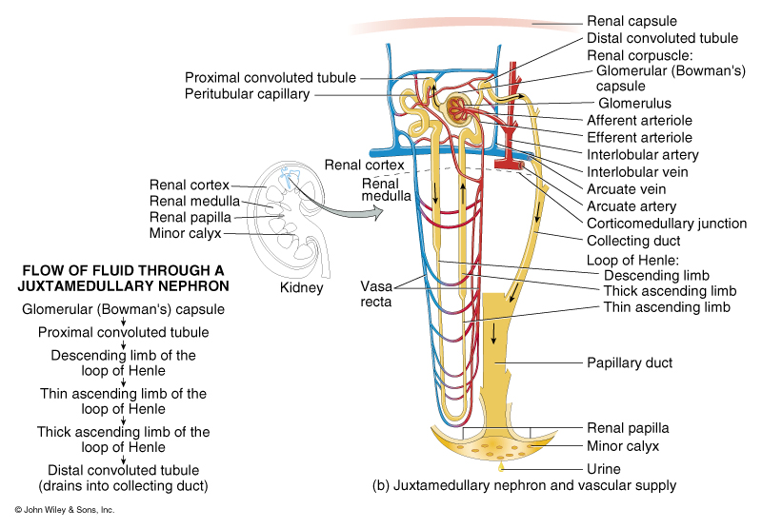
Major Functions of the Kidneys and the Urinary System
8. Excretion of wastes and foreign substances

Slide 5
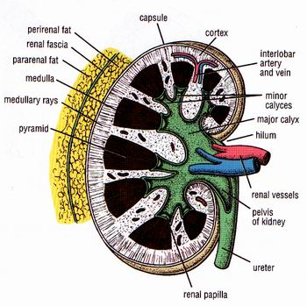
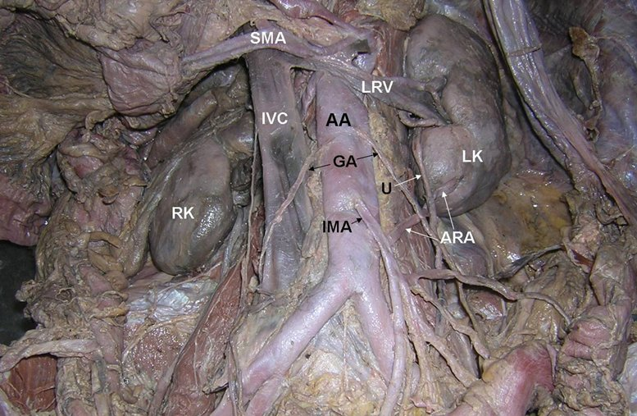
Location of the kidney
Three layers of tissue surround each kidney:
1. renal fascia (outermost layer)
2. adipose capsule (middle layer)
3. renal capsule (innermost layer)
The Kidney is Retroperitoneal:
In a pocket of the parietal Peritoneum against the dorsal wall of the abdomen.

Slide 6
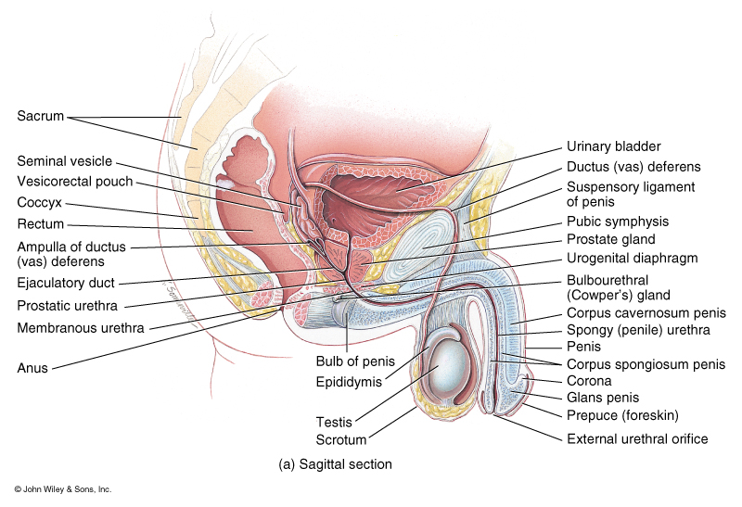
The Male Urethra
Specializations of the male urethra:
Prostatic urethra
Membranous urethra
Penile urethra
Urology: The branch of Medicine related to health care of the male and
female Urinary system (Bladder and urethra) and the male reproductive
system is called.

Slide 7
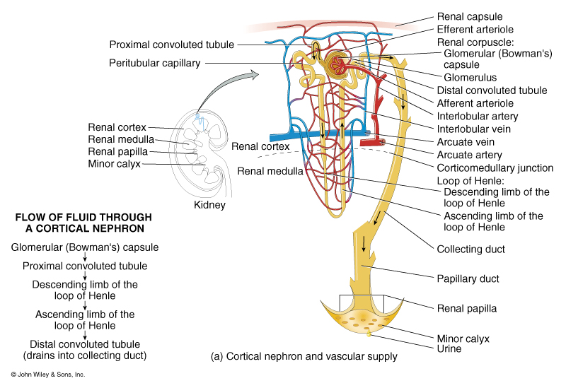
Nephron: The Functional Unit of the Kidneys
Nephrology: The specialized branch of medicine that deals with structure,
function of the Kidney in urine formation.
Cortical Nephrons:
80 to 85% of nephrons. Have short Loops of Henle that lay mainly in the cortex
Juxtamedullary Nephrons:
15 to 20% of nephrons. Have long Loops of Henle that extend into the deepest regions of the medulla. Produce the most concentrated urine.

Slide 8
The Anatomy of a Nephron
Subdivision of a Nephron:
Renal Corpuscle
Proximal Convoluted tubule
Descending Loop of Henle
Ascending Loop of Henle
Distal Convoluted tubule
Collecting duct
Papillary duct

Slide 9
Urine Drainage through the Kidney and body
From papillary duct
Minor Calyx
Major Calyx
Renal pelvis
Ureter
Urinary Bladder
Urethra:
prostatic
membranous
penile

Slide 10
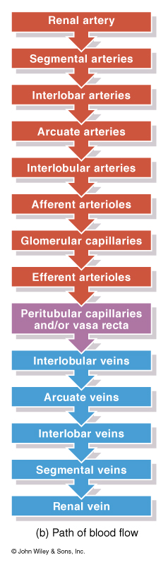
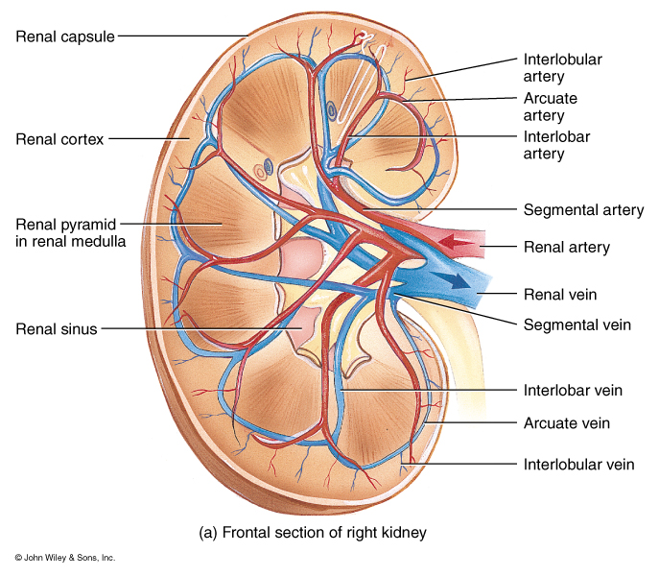
Blood flow through the Kidney

Slide 11
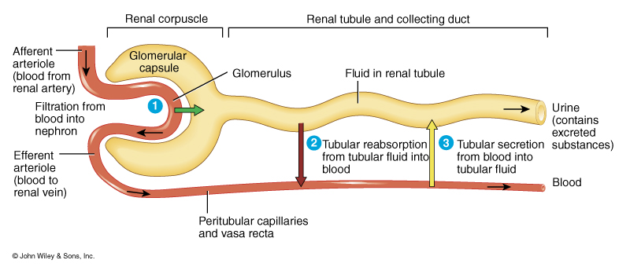
Basic Functions of a Nephron
Nephrons perform three basic functions:
1. glomerular filtration
2. tubular reabsorption
3. tubular secretion

Slide 12
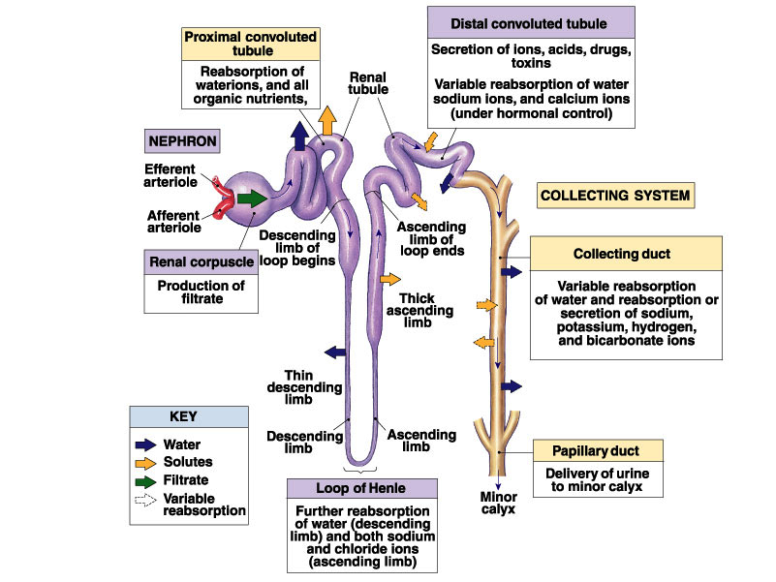

Slide 13
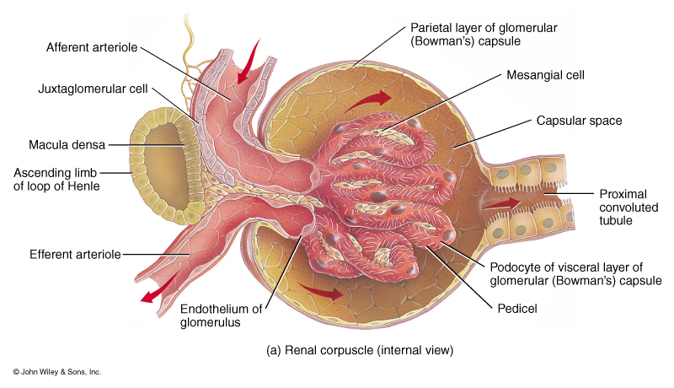
The Glomerular Filtration Membrane
The filtration membrane is the filtering unit of a nephron.
This endothelial-capsular membrane consists of:
1) the glomerular endothelium
2) the glomerular basement membrane
3) slit membranes between pedicels of podocytes

Slide 14
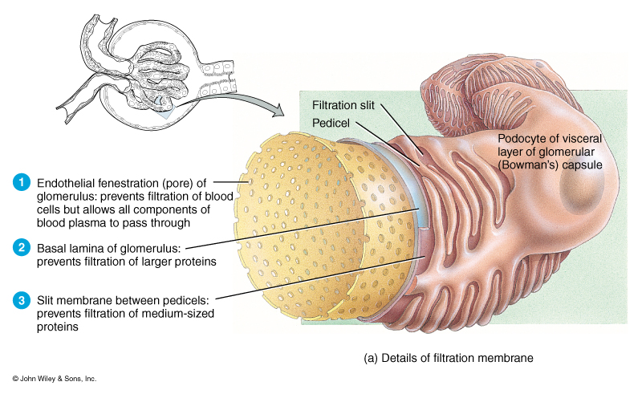
The Glomerular Filtration Membrane

Slide 15
Filtration Pressures and Glomerular Filtration Rate
Filtration Pressure is the force that drives the fluid and its dissolved substances through the glomerular filter
Net Filtration pressure NPF (or Net Hydrostatic Pressure NHP) is the difference between three pressures:
1. Glomerular (blood) hydrostatic pressure GHP or GBHP
2. Capsular Hydrostatic Pressure (CHP)
3. (Blood) Colloid Osmotic Pressure (BCOP)
The relationship can be expressed by
NPF = GBHP – (CHP + BCOP)
Glomerular Filtration Rate: amount of filtrate the kidneys produce each minute. (about 125 ml per minute)
Determined by a creatinine clearance test

Slide 16
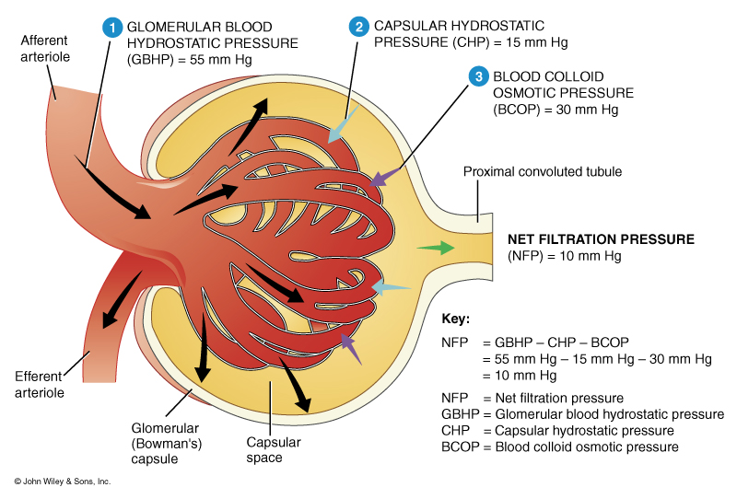
Factors affecting filtration rate in the kidney

Slide 17
Regulation of Glomerular Filtration Rate
Renal Auto-regulation
Regulation | Major Stimulus | Mechanism | Effect on GFR
Myogenic | Stretching of afferent arteriole walls due to increased systematic BP | Contraction of smooth muscles in afferent arteriole wall | Decrease GFR by constricting the lumen
 | Decline in glomerular blood pressure | Dilation of AA and G. capillaries Constriction of EA | Increases GFR

Slide 18
Regulation of Glomerular Filtration Rate
Neural Regulation
Regulation | Major Stimulus | Mechanism | Effect on GFR
Tubuloglomerular feedback | Rapid increase in Na+ and Cl- In lumen at the macula densa due to increased BP | Decreased release of Nitric Oxide by JGA causing AA constriction | Decrease GFR and filtrate volume

Slide 19
Regulation of Glomerular Filtration Rate
Neural Regulation
Regulation | Major Stimulus | Mechanism | Effect on GFR
Sympathetic Nerves (Autonomic) | Acute fall in systematic blood pressure. Release of norepinephrine | Constriction of afferent arterioles | Decrease GFR and filtrate volume to maintain blood volume

Slide 20
Regulation of Glomerular Filtration Rate
Hormonal Regulation
Regulation | Major Stimulus | Mechanism | Effect on GFR
Angiotensin II | Decreased blood volume or decreased blood pressure | Constriction of both afferent and efferent arterioles | Decreases GFR
Atrial natriuretic peptide | Stretching of the arterial walls due to increased blood volume | Relaxation of the mesangial cells increasing filtration surface | Increases GFR

Slide 21
Regulation of Glomerular Filtration Rate
Hormonal Regulation
Regulation | Major Stimulus | Mechanism | Effect on GFR
Antidiuretic hormone ADH | Increased Angiotensin II or decreased volume of extracellular fluid | Stimulate insertion of aquaporin-2 (water channels) In apical membrane or principal cells | Increases blood volume to return GFR to normal
Aldosterone | Secreted from adrenal cortex because of increased Angiotensin II levels | Increases reabsorption of Na+ and water by principal cells of the DCT collecting duct | Increases blood volume to return GFR to normal

Slide 22
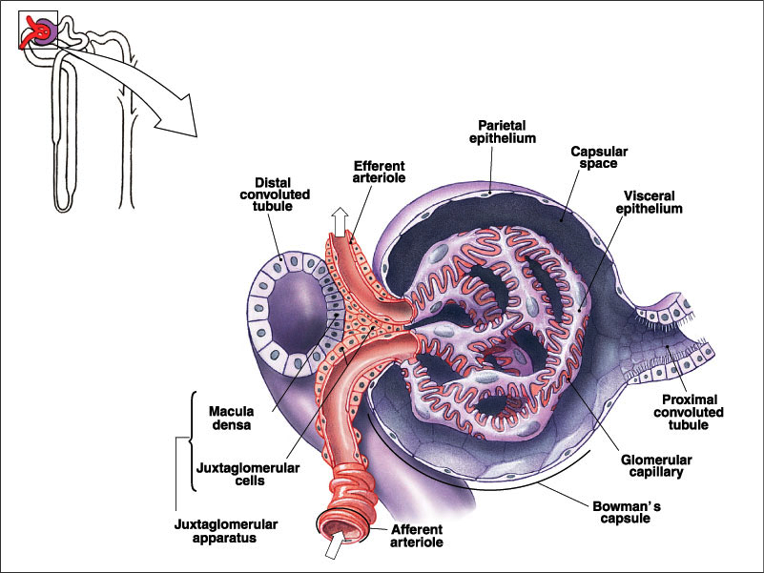
juxtaglomerular apparatus (JGA)
Consist of the juxtaglomerular cells of an afferent or efferent arteriole and the
macula densa cells of the distal convoluted tubule. The JGA helps regulate
blood pressure and the rate of blood filtration by the kidneys.

Slide 23
Angiotensin II Pathway
Renin is released to the blood by JGA cells due to decreased renal blood flow or perfusion.
Renin converts a plasma protein (angiotensinogen) into angiotensin I
Angiotensin-Converting Enzyme (ACE) in the lungs convertes Angiotensin I into Angiotensin II

Slide 24
Renin – Angiotensin - Aldosterone System

Slide 25
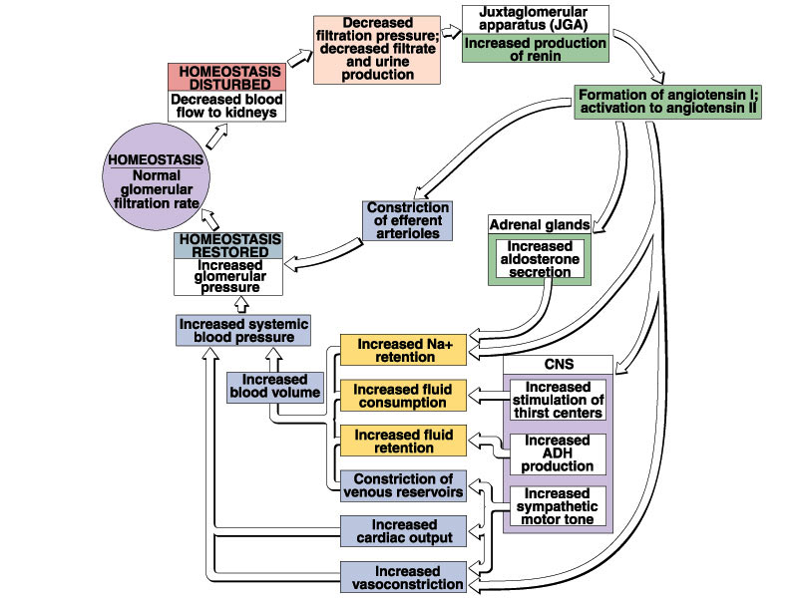

Slide 26
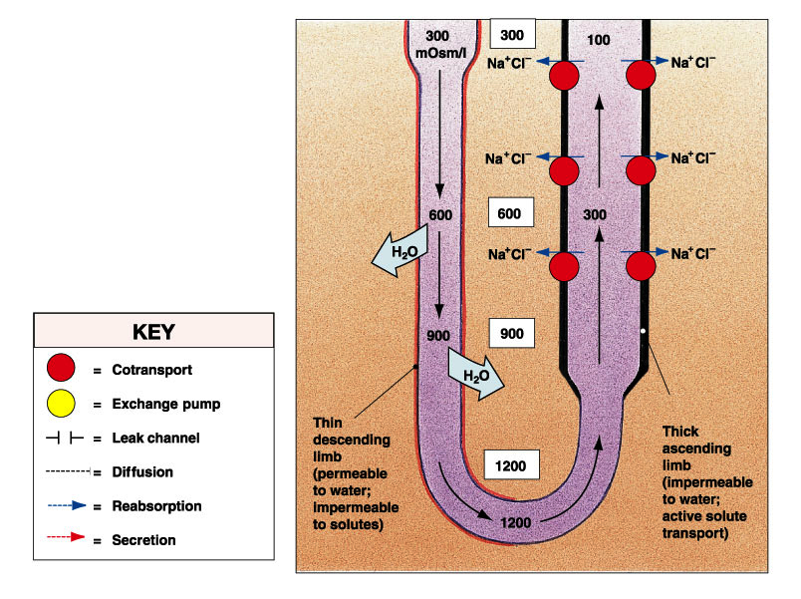
Urine Concentration via
Countercurrent Multiplication
Thin descending limb of Henle is permeable to water but not
solutes
Thick ascending limb of Henle is impermeable to water and solutes. Contains active transport mechanisms for sodium and chloride.

Slide 27
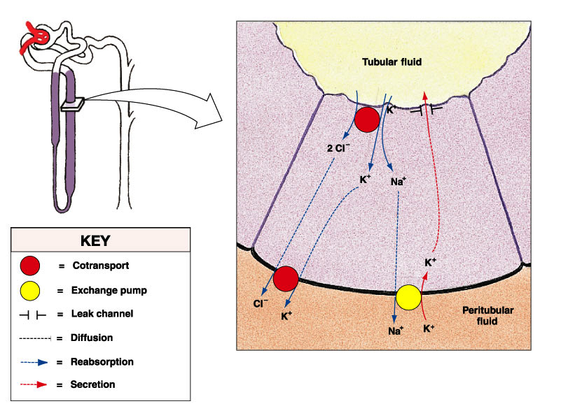
Urine Concentration via
Countercurrent Multiplication
Sodium and Chloride are reabsorbed by thick ascending limb into the peritubular fluid
These ions elevate the medulla osmotic pressure
This increases osmotic flow of water out of the thin descending limb
Increased osmotic potential of tubular filtrate increases active transport in the TAL

Slide 28
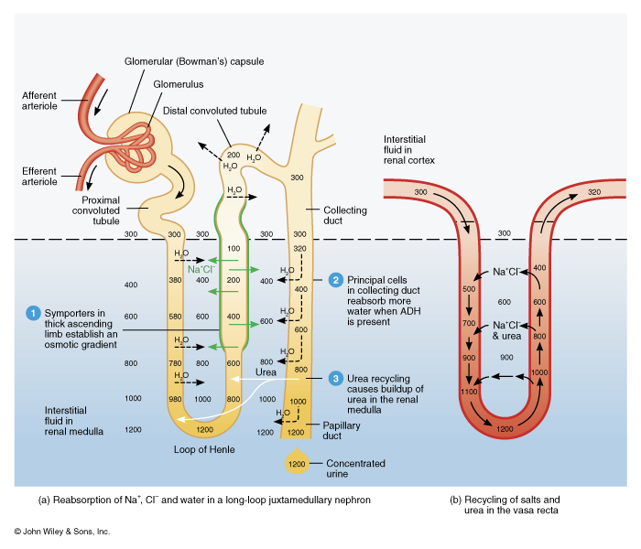
Urine Concentration via
Countercurrent Multiplication

Slide 29
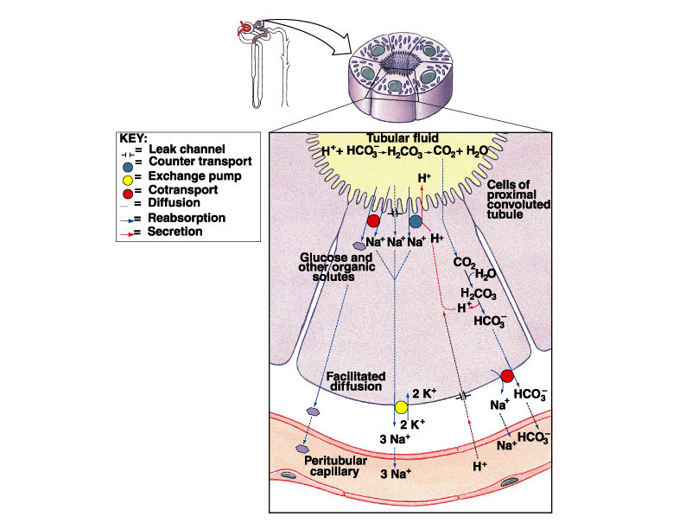
Roles of the Different Nephron Regions in Urine Formation
Proximal Convoluted tubule
Reabsorption:
60%-70% of water (108 to 116 L/D)
(obligatory water reabsorption)
100% of glucose and other sugars, amino acids, and some vitamins
60%-70% sodium and chloride, along with calcium, magnesium, phosphate, and bicarbonate
Secretion:
Hydrogen ions, ammonium ions, creatinine, drugs, toxins

Slide 30
Roles of the Different Nephron Regions in Urine Formation
Loop of Henle
Reabsorption:
Descending limb
25% of the water
(obligatory water reabsorption)
Thick Ascending limb
20-25% of the sodium and chloride to help maintain the countercurrent system

Slide 31
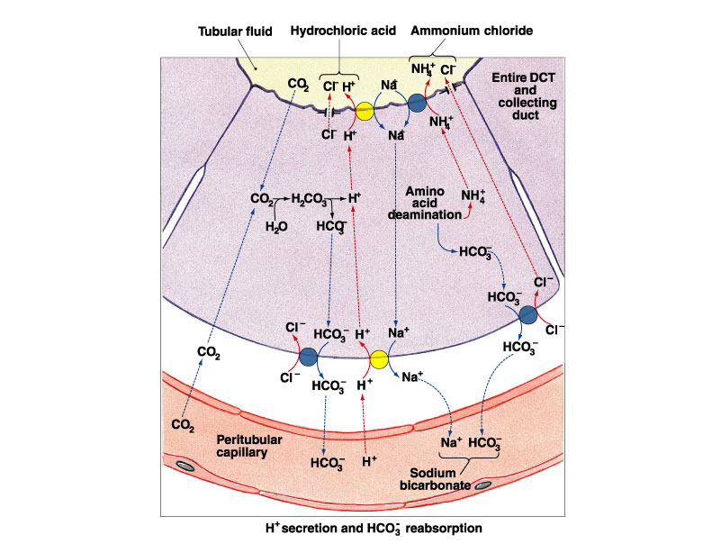
Roles of the Different Nephron Regions in Urine Formation
Distal Convoluted Tubule
Reabsorption:
Up to 5% of water under ADH control (principle cells)
(Facultative water reabsorption)
Variable amounts of sodium and chloride under Aldosterone control (principle cells)
Variable amounts of bicarbonate
(intercalated cells)
Variable amounts of Calcium
controlled by parathyroid hormone
Secretion:
Hydrogen ions, ammonium ions,
Creatinine, drugs , toxins

Slide 32
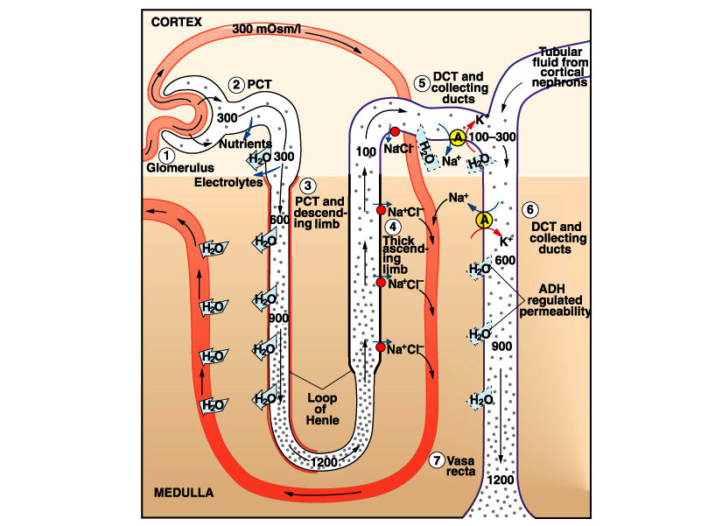
Roles of the Different Nephron Regions in Urine Formation
Collecting Duct
Reabsorption:
Variable amounts of water under ADH control (principle cells)
(Facultative water reabsorption)
Variable amounts of sodium and chloride under Aldosterone control (principle cells)
Variable amounts of bicarbonate
(intercalated cells)
Secretion:
Potassium and hydrogen ions

Slide 33
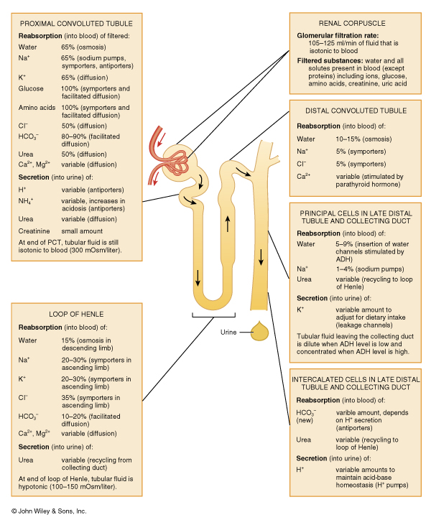
Summary of the roles of the different nephron regions in urine formation

